Slide 1

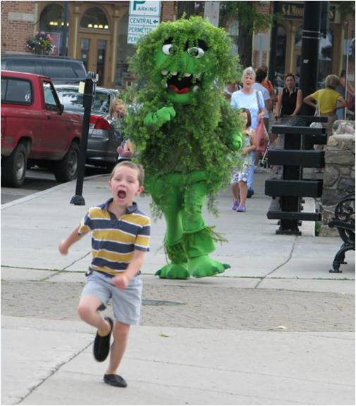
Let’s Talk About Water Quality:
COFOKLA June Meeting
Scott Kishbaugh, P.E.
Chief, Lake Monitoring and Assessment Section
NYSDEC Division of Water

Slide 2
Why we (the state of New York) sample
  Baseline water quality monitoring
    WI-PWL, 106, 305(b), 303(d)
    Problem identification
    Trends evaluation
    100% assessment
  Water quality research
    Development of water quality standards
    Acid rain impacts
    Fish kills
    HABs
  In support of management
    Fish stocking
    TMDLs (development and post)
    Lake management actions
    Permit conditions
  Public complaints or “incidents”
    Fish kills
    HABs
    Invasive species

Slide 3
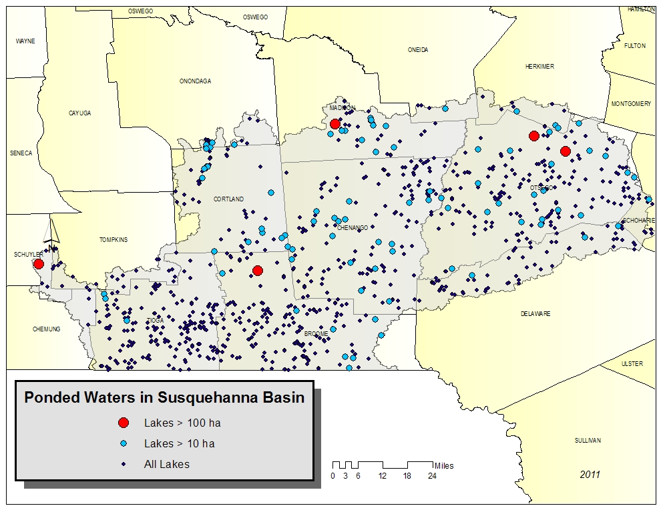
Lake Resources in Susquehanna River Basin
Appx. 130 “significant” lakes, ponds and reservoirs in basin (named and > 6.4 acres) comprising appx 13,800 acres
Largest three lakes > 50% of lake acres:
  Otsego Lake- 4100 acres
  Canadarago Lake- 1880 acres
  Whitney Point Reservoir- 1230 acres
Appx. 860 named and unnamed ponds/lakes/reservoirs > 0.1 acres or larger

Slide 4
2009 Susquehanna Basin PWL Assessment

Slide 5
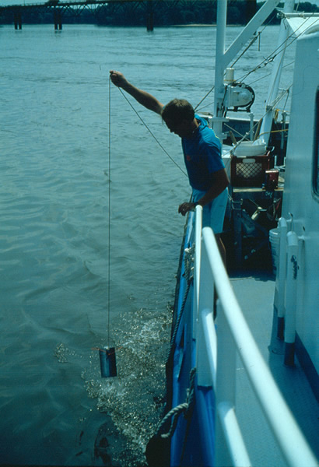
Historical Lake Water Quality Data
Cortland-Onondaga Kettle Lakes
1935 Biological Survey
  37 lakes and ponds sampled from the Susquehanna River basin for water quality and 35 lakes sampled for fish communities
  21 lakes and pones surveyed for aquatic plants
  ULY, Tully, Goodale, Song, Crooked sampled
1972 National Eutrophication Survey
  1 Susquehanna basin lakes sampled (Goodyear Lake)
1984 Eastern Lakes Survey
  4 Susquehanna basin lakes sampled (Afton, Guilford, Solon, Woodman Lakes)
1991-93 EMAP, 2007 National Lake Assessment
  No Susquehanna basin lakes sampled
2012 National Lake Assessment (SRBC)
  No Susquehanna basin lakes sampled

Slide 6
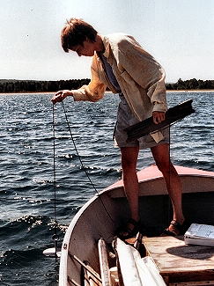
NYSDEC Lake Monitoring Programs
Lake Classification and Inventory (LCI) Survey
NY Citizens Statewide Lake Assessment Program (CSLAP)
Fisheries monitoring programs
(NYSOPRHP lake/beach monitoring)

Slide 7
LCI
DOW baseline monitoring program
LCI is the lakes equivalent to the RIBS program
Initially conducted 1976 and 1982-1987
Present LCI conducted since 1996
Sampling conducted by DEC DOW staff from Albany and regional offices
11 Susquehanna River basin lakes sampled at least 1x though LCI in 1982-2009

Slide 8
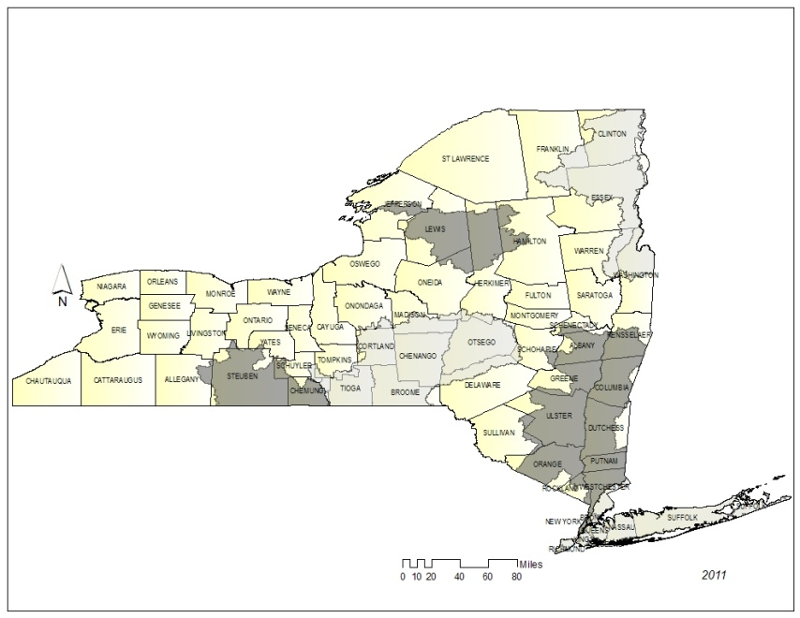
LCI Candidates 2013-14
Present Program Divided Into Two Cycles:
  2013 First Year: Screening
    Susquehanna River Basin
    Atlantic Ocean/Long Island Sound Basin
    Lake Champlain Basin
  2013 Second Year: Intensive
    Black River Basin
    Chemung River Basin
    Lower Hudson River Basin

Slide 9
Previous Susquehanna Basin LCI Lakes
Lake | County | Year(s)
Afton Lake | Chenango | 1998-1999
Arctic Lake | Broome | 1984
Bear Swamp Pond | Otsego | 2003
Bowman Lake | Chenango | 1984, 2009-10
Canadarago Lake | Otsego | 1984, 89, 2003, 09
Cayuta Lake | Schuyler | 2009
Chenango Lake | Chenango | 1984, 1998-99
Chenango Lake | Broome | 2004
Craine Lake | Madison | 2008-09
East Sidney Reservoir | Delaware | 1984, 2009
Geneganslet Lake | Chenango | 2003
Gilbert Lake | Otsego | 1984
Goodale Lake | Cortland | 2006
Goodyear Lake | Otsego | 1984, 2003-04
Guilford Lake | Chenango | 1998-99
Hunt Pond | Otsego | 1984, 2004
Labrador Pond | Cortland | 2008
Lake | County | Year(s)
Lake Ludlow | Chenango | 2008-09
Lake Moraine | Madison | 1998, 2003
Lily Lake | Broome | 2008
Lower Little York Lake | Cortland | 2009
Melody Lake | Cortland | 2009
Norwich Reservoir | Chenango | 1998
Otsego Lake | Otsego | 1984, 1989
Petonia Lake | Chenango | 2008
Plymouth Reservoir | Chenango | 2008
Sexsmith Lake | Chenango | 2008
Silver Lake | Otsego | 2004
Summit Lake | Otsego | 2004
Titus Lake | Delaware | 2003
Tully Lake | Cortland | 1984, 1998-99
Upper Little York Lake | Cortland | 1984, 1998-99
Whitney Point Reservoir | Broome | 1998, 2000
Wilbur Lake | Otsego | 2003
Woodman Pond | Madison | 2003

Slide 10

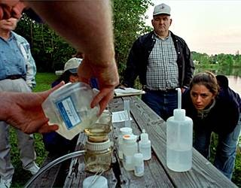
CSLAP
Water samples collected by trained lay volunteers every other week for 15 weeks (8 samples)
Sampling focuses on lake eutrophication indicators (“greenness”)
  Water clarity (Secchi disk transparency)
  Nutrients (phosphorus and nitrogen)
  Algae (chlorophyll a)

Slide 11
CSLAP
Other water quality indicators:
  Lake acidity (pH)
  Dissolved organics (“natural” color)
  Dissolved ions (conductivity)
  Susceptibility to zebra mussels (calcium)
  Potable water indicators (iron, manganese, ammonia, arsenic)
  Lake perception
  Algal toxins (SUNY ESF and NYSDOH studies)
Aquatic plant identifications
Special studies on select lakes
  Shoreline/riparian zone survey
  Zebra mussel survey (drop a brick)
  Lake level / ice-in/out evaluations
  Angler survey
  Boater survey

Slide 12
CSLAP
Candidate lakes chosen by NYS Federation of Lake Associations (NYSFOLA)
23 Susquehanna River basin lakes have been sampled through CSLAP
18 basin lakes will be sampled through CSLAP in 2013

Slide 13
CSLAP Lakes in the
Susquehanna River Basin
Lake Name | County | Years of Sampling
Arnold Lake | Otsego | 1987-1991, 1995
Beaver Lake | Broome | 1991-1994, 2002-2010, 2012-2013
Canadarago Lake | Otsego | 1989-1993
Chenango Lake | Chenango | 2000-2010, 2012-2013
Craine Lake | Madison | 1988-1994, 1996-1998, 2000-2001, 2009-2013
Crooked Lake | Onondaga | 1986-1990, 1993-1998, 2009-2013
Eatonbrook Reservoir | Madison | 1988-2000, 2010-2013
Echo Lake | Chenango | 1991-1995, 2002-2010, 2012-2013
Geneganslet Lake | Chenango | 1990-2010, 2012-2013
Gorton Lake | Madison | 1988-2006
Guilford Lake | Chenango | 2004-2008, 2012-2013
Hatch Lake | Madison | 1988-1996, 1998-2001, 2004, 2011-2013

Slide 14
CSLAP Lakes in the
Susquehanna River Basin
Lake Name | County | Years of Sampling
Lake Gerry | Chenango | 2004-2005
Lake Moraine | Madison | 1986-2013
Lebanon Reservoir | Madison | 1988-1994, 1997-2001, 2004-2005, 2011-2013
Melody Lake | Cortland | 1987-1991, 1994, 1997-2013
Petonia Lake | Chenango | 1986-1990, 2001-2013
Plymouth Reservoir | Chenango | 1991-2010, 2012-2013
Song Lake | Cortland | 2009-2012
Tully Lake | Onondaga | 2012-2013
Upper Little York Lake | Cortland | 2009-2013
Warn Lake | Chenango | 1991-1996, 2001-2010, 2012-2013
White Birch Lake | Broome | 1996-2000, 2013

Slide 15
So what does this data tell us?
Most WQ monitoring programs focus on key indicators
  Eutrophication indicators
  “Habitat” indicators
  Presence of invasive species
All WQ data should be evaluated in context
  Location (location, location…)
  “Designated” use
  Water quality standards/criteria

Slide 16
Water clarity strongly correlated with algae and nutrient levels and public perception
No state WQ standard, but 4 ft (1.2m) needed for swimmer safety
Clarity > 5 meters typical of oligotrophic lakes; < 2 meters typical of eutrophic
Most COFOKLA lakes have above average clarity and should support swimming

Slide 17
Algae levels (measured by chl.a) strongly correlated with nutrient levels, public perception, and susceptibility to potable water/swimming problems
No state WQ standard, but 10 ug/l likely to be proposed as swimming criteria (guidance value)
Chl.a < 2 ug/l typical of oligotrophic lakes; >8 ug/l typical of eutrophic lakes
Most COFOKLA lakes have below average algae levels and should support swimming

Slide 18
Total phosphorus strongly correlated with algae and water clarity, and enters to water from external and internal (and regulated) sources
Existing NYS guidance value of 0.020 mg/l
TP < 0.01 mg/l typical of oligotrophic lakes; >0.02 mg/l typical of eutrophic
Most COFOKLA lakes have below average TP levels and should support swimming

Slide 19
Total phosphorus levels exceed guidance values in
  0% of Upper Little York Lake samples 4% of Crooked Lake samples
  24% of Song Lake samples 38% of Tully Lake samples
Deepwater TP highly elevated in Crooked Lake, somewhat elevated in Song and Tully Lakes, not in ULY Lake (others too shallow)

Slide 20
pH needs to fall within narrow range to support aquatic life
Existing NYS WQ standards of 6.5 and 8.5
pH < 7 = acidic; pH > 7 = alkaline; most NYS lakes outside small high elevation Adirondack/Catskill lakes are alkaline
Most COFOKLA lakes have alkaline pH and should support aquatic life
pH in Crooked/Song Lakes decreasing slightly over time
1935 pH readings > 8.4 in all lakes

Slide 21
Conductivity indicative of geologic conditions but changes in conductivity may indicate pollutant inputs and impending changes
No NYS WQ standards or guidance values
Conductivity < 150 indicative of softwater lakes; conductivity > 300 indicative of hardwater lakes
Great variability in COFOKLA lakes

Slide 22
Calcium indicative of susceptibility to zebra mussels
No NYS WQ standards or guidance values
Calcium levels > 20 indicative of moderate susceptibility; calcium > 30 indicative of high susceptibility
Great variability in COFOKLA lakes, consistent with conductivity

Slide 23
Other “historical” findings
Dissolved oxygen:
  Upper Little York, Crooked, Goodale- hypoxic in 1935
  Song, Tully- anoxic in 1935
  UFI study evaluating whether lakes are “naturally” hypoxic/anoxic
Aquatic plants:
  Tully Lake dominated by muskgrass, slender naiad, white stemmed pondweed, and hardstem bulrush in 1935
  Upper Little York Lake dominated by coontail, northern milfoil, white water crowfoot, common bladderwort, and water stargrass in 1935
  Crooked Lake dominated by water stargrass and largeleaf pondweed in 1935
  Song Lake dominated by lake quillwort, largeleaf pondweed, and Illinois pondweed in 1935
  Protected plants: water marigold found in all lakes in 1935, and common mare’s tail found in Upper Little York Lake in 1935

Slide 24
Other “historical” findings
Fish: most abundant species
  Crooked Lake- bullhead catfish, yellow perch
  Song Lake- common sunfish, redbellied sunfish, yellow perch
  Tully Lake- barred killifish, common sunfish, yellow perch
  Upper Little York Lake- common eel, mad tomcat, smallmouth bass
  No salmonids found in any of these lakes (though Little York Lake presently stocked with rainbow and brown trout)

Slide 25
Invasive Species
Eurasian watermilfoil
  Crooked Lake
  Goodale Lake
  Tully Lake
  Upper Little York Lake
Curly-leafed pondweed
  Tully Lake (1935)
Zebra mussels
  Upper Little York Lake

Slide 26
2013 and Beyond:
What COFOKLA Lakes Should Look For…
Harmful Algae Blooms
  Presence of Blooms
  Algal Toxins
Invasive Plants
  Hydrilla
  Water chestnut
Invasive Animals
  Zebra mussels
  Asian carp

Slide 27
Susceptibility to Lakewide Algae Blooms
Crooked, Tully, ULY, LLY
Song

Slide 28
What factors lead to algal toxin production?

Slide 29
What factors lead to algal toxin production?

Slide 30
Seasonal Change in Algae Levels

Slide 31
Bloom Occurrence

Slide 32
Susceptibility to Blue Green Algae

Slide 33
Susceptibility to BGA Blooms

Slide 34
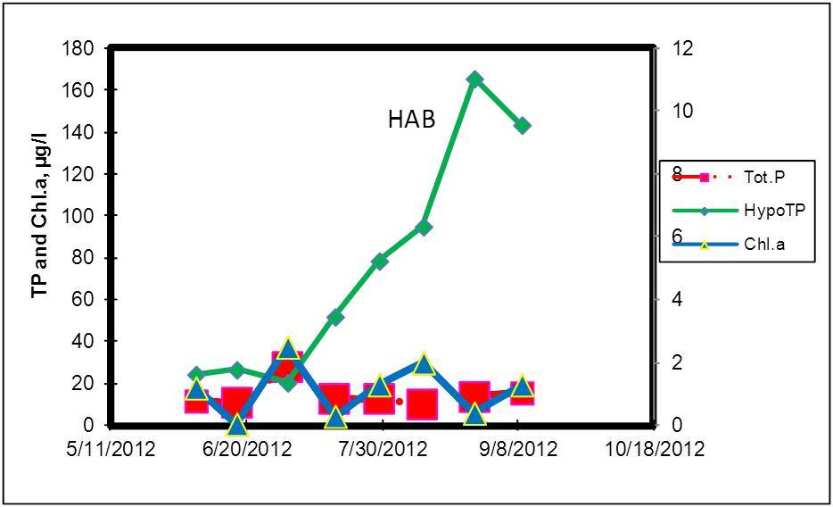
2012 Seasonal Changes, Craine Lake

Slide 35
Susceptibility of COFOKLA Lakes to HABs?
All lakes are mesotrophic
Song Lake
  Shallow stratified
  Zebras?
Tully Lake
  Shallow stratified
  Zebras?
Upper Little York Lake
  Strongly stratified (deep)
  Zebras
Lower Little York Lake
  Weakly stratified (shallow)
  Zebras?

Slide 36
NYS distribution of hydrilla
Orange County/Hudson River basin- 1 small pond
Long Island/Atlantic Ocean-LI Sound- 7 lakes and ponds
Cayuga Inlet/Great Lakes basin
Erie Canal/Tonawanda Creek
Broome County- 3 small ponds
Two NYS infestations within 60 miles of COFOKLA lakes

Slide 37
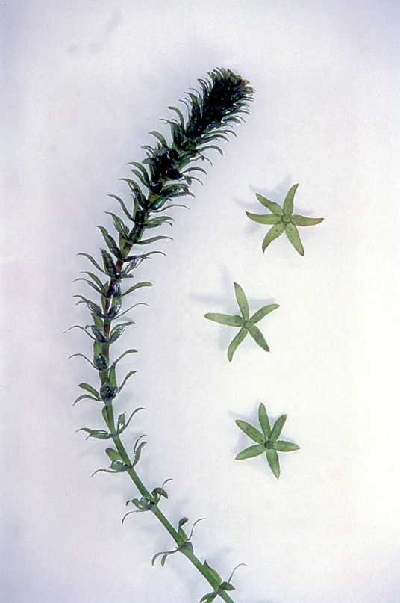
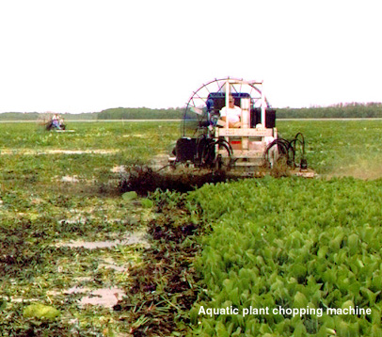
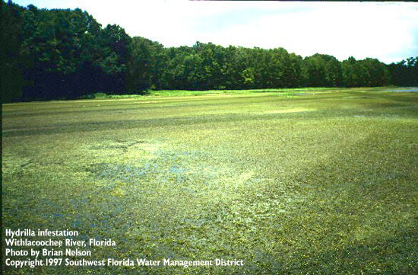
Introduction to Hydrilla- Why Do We Care?
Perennial plant (that regrows from tubers and turions), produces dense mats on surface and throughout lake
Grows in wide variety of depths, bottom and water quality types, including 7% salinity, high and low nutrients, high and low acidity
State of Florida spends $18-30M annually to “manage” (not control) lakes and canals
Listed as federally “noxious” weed
Considered most aggressive invasive aquatic plant
Ranked “highly invasive” in NYS (score of 91 out of 100)

Slide 38
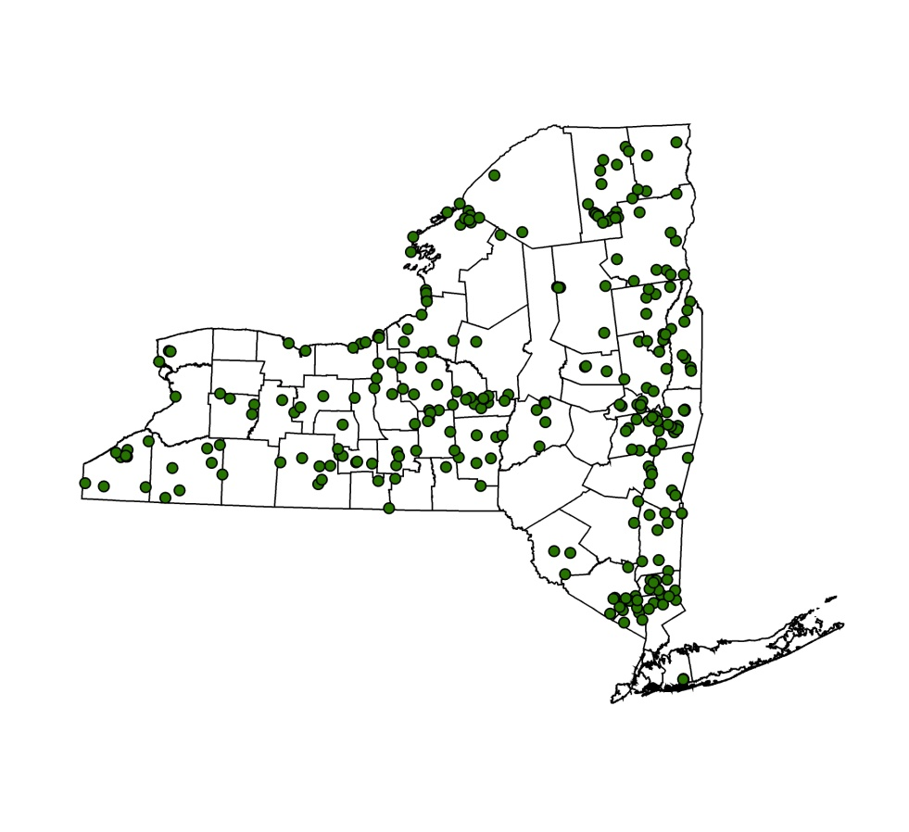
Why Do We Care About Hydrilla?
Turning back the clock to the 1940s
Knowledge/concerns about invasive species in its infancy
Eurasian watermilfoil first found in the Finger Lakes region in 1940s
Eradication only conceivable with use of obsolete pesticides (including arsenic based chemicals) or dredging
Present eradication tools not developed until early 1960s
By then, Eurasian watermilfoil had escaped from the Finger Lakes
Now found everywhere in NYS and dominates many lake plant communities
Hydrilla at portal of Great Lakes basin and new invader in specific waterbodies provides unique opportunity to eradicate as if “turning back the clock” to the 1940s for EWM

Slide 39
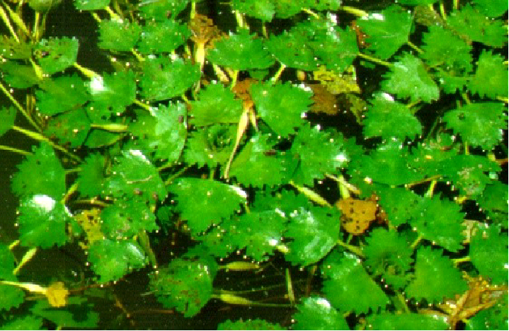
Water chestnut- Ugly invader or Paper tiger?
Water chestnut was introduced to NYS and North America in the early 1880s
Spread throughout Hudson River/ Mohawk River basins and via Erie Canal to western NYS.
Thickly clogs slow moving waterbodies and shallow portions of lakes
Can create significant navigation, swimming, and ecological impacts
However, all is not lost:
  VERY easy to identify
  Can be removed by several plant management tools
  Can be eradicated with persistent efforts

Slide 40
Invasive Animals
Asian clam
  Found through NYS since at least the 1950s (Long Island introduction)
  > $400k spent in Lake George in fall 2012 alone
Zebra mussels
  Introduced in NYS in early 1980s in Great Lakes
  Widespread through NYS
  Bacterial control agent (at water intakes for now) being evaluated
  May be found in other COKOFOLA lakes
Asian carp
  Not yet found in NYS
These invaders (+ spiny water flea and hydrilla) driving need for updated state ANS plan

Slide 41
Susceptibility to Zebras?
Actions:
Drop a brick
Close patrol of boaters
Reducing calcium runoff
Reducing use of concrete structures
A = lakes with zebra mussels and public access
B = lakes with zebra mussels and no public access
C = lakes w/o zebra mussels, without public access, and within 15 miles of a zebra mussel location
D = lakes w/o zebra mussels, with public access, and within 15 miles of a zebra mussel location
E = lakes w/o zebra mussels, w/o public access, and more than 15 miles from a zebra mussel location
F = lakes w/o zebra mussels, with public access, and more than 15 miles from a zebra mussel location

